Slide 1
Mathematical Association of America Highlights 2010 and Preview 2011 Presentation for Section Governors Winter / Spring 2011

Slide 2
Publications
Seventeen new books were published in 2010. Twenty titles are in production for publication in 2011.
MAA Textbooks are thriving, with many textbook titles on the bestseller list of 2010.
Our new Electronic Bookstore is now live!
Fourteen titles are currently available. All of the NML books are being added along with several other older titles that are no longer in print.
Books are available as Secure PDFs or Print-On-Demand paperbacks.
URL: www.maa.org/ebooks

Slide 3
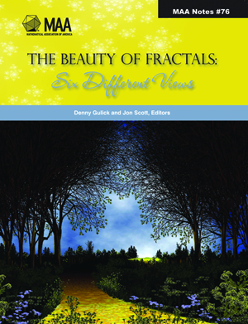
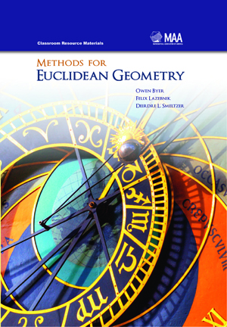
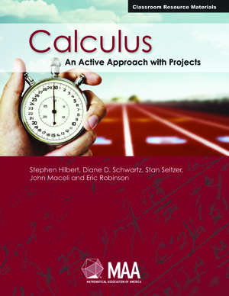
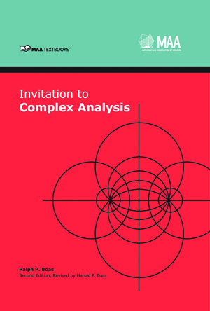
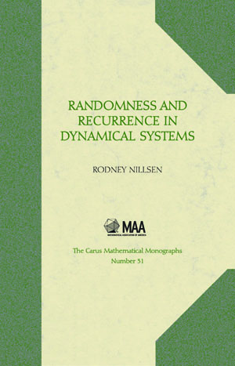
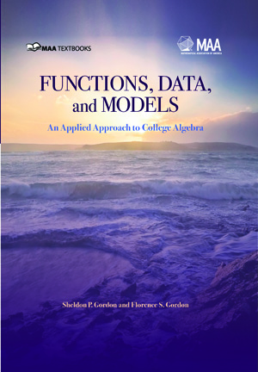
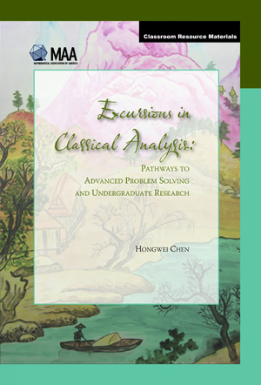
2010 Publications

Slide 4
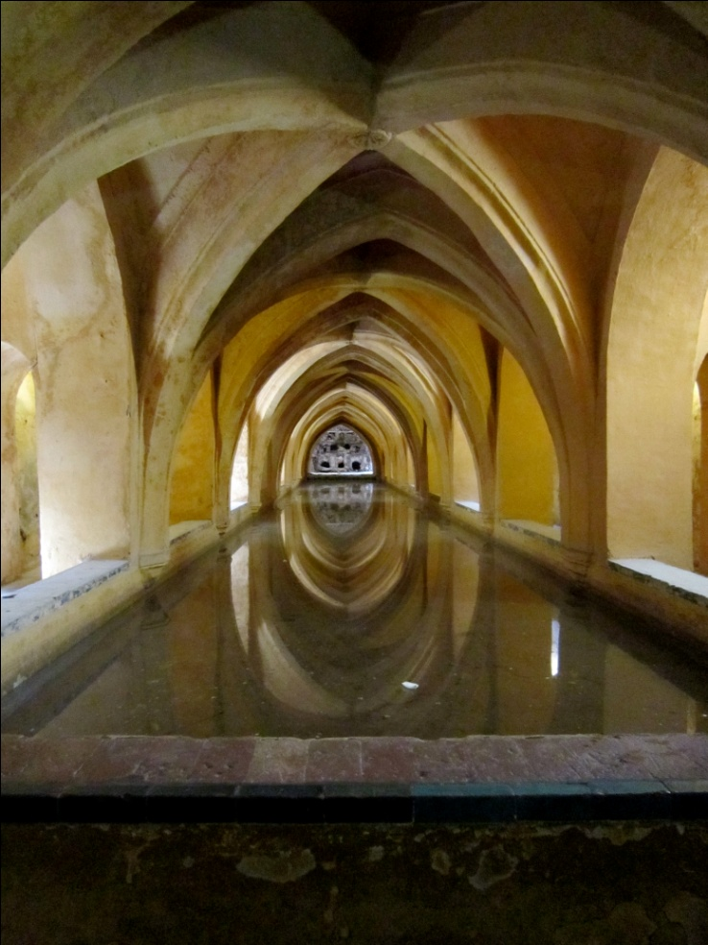
Opportunities for Faculty
Project NExT:
Over 1250 Fellows and Counting.
Encourage new faculty to apply.
MAA Professional Enhancement Program (PREP):
NSF funding extends through 2013.
More information at: www.maa.org/prep.

Slide 5
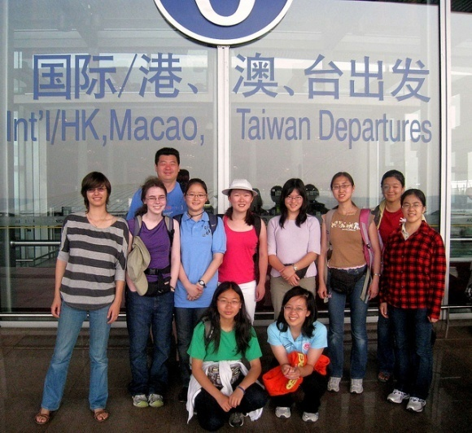
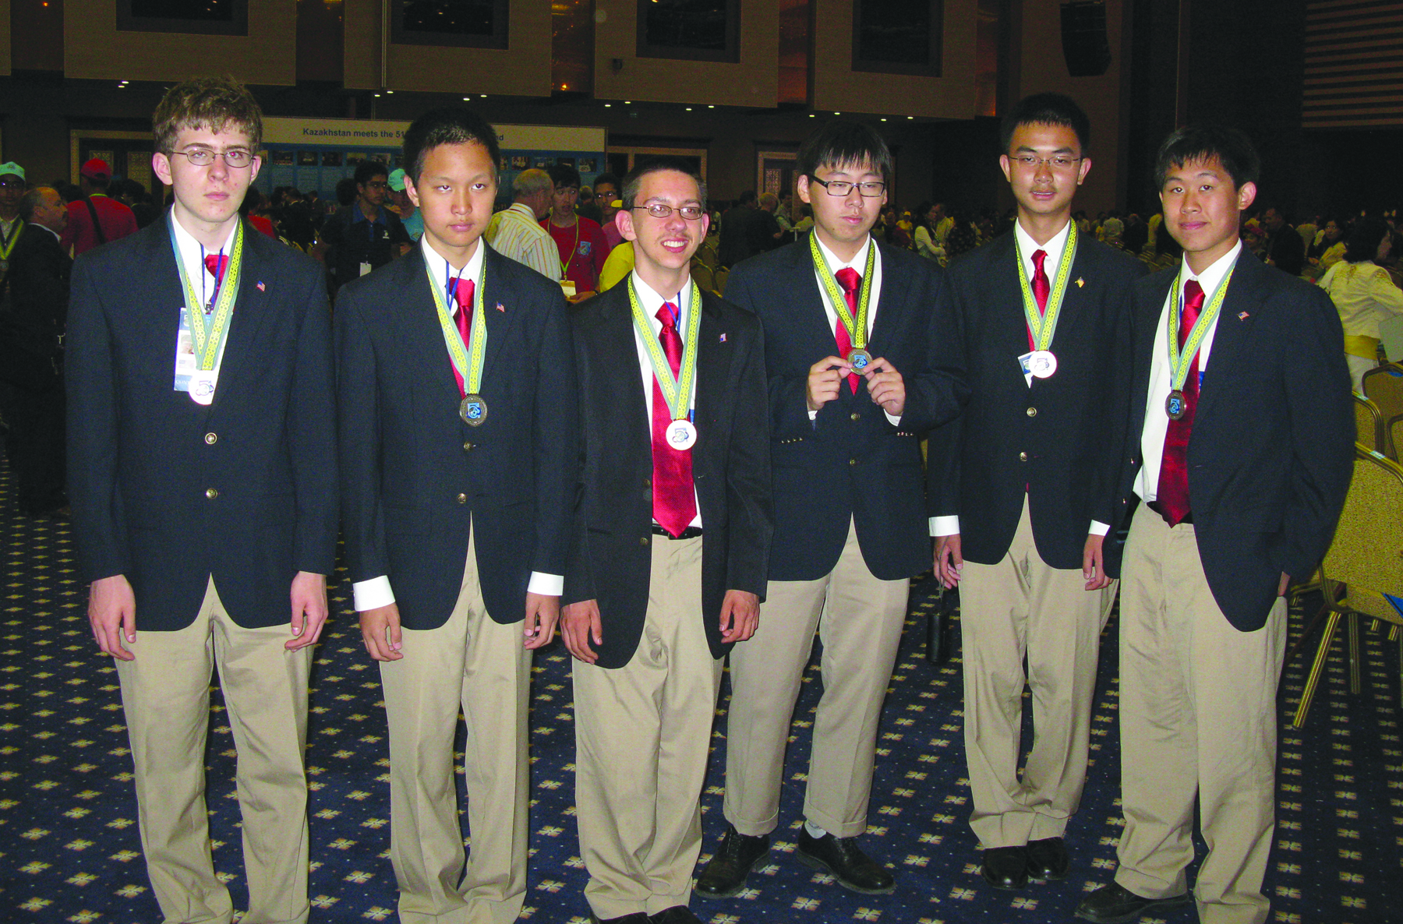
American Math Competitions
Almost 400,000 exams taken at all grade levels. College and universities can host contests and strengthen ties with high schools and bright students.
MAA co-sponsored participation of 2 4-member
teams of high school girls in the 2010 China Girls
Math Olympiad held in Shijiazhuang, China,
August 9-13, 2010. One team of 4 placed 2nd
overall. (1 Bronze, 1 Silver, 5 Gold total).
2010 International Mathematical Olympiad held in Astana, Kazakhstan the U.S. 6-member team placed third in the world.
Team members individually won 3 silver
medals and 3 gold medals.
More information at: http://amc.maa.org

Slide 6
Outreach Programs for Students
Tensor Grants for Women in Mathematics. Deadline: February 12.
Tensor – SUMMA Grants: Strengthening Underrepresented Minority Mathematics Achievement. Deadline: February 12.
Dolciani Mathematics Enrichment Grant (DMEG) program. Deadline: February 12.
National Research Experiences for Undergraduates Program to broaden participation in the mathematical sciences. Deadline: February 25.
Regional Undergraduate Mathematics Conferences. Proposals requested by May 15 for following academic year.
If you missed these submissions, look for solicitations again in Fall 2011 for 2012 funding. More information on the “Funding Opportunities” page at www.maa.org.

Slide 7
Public Policy
December 2010: America COMPETES is reauthorized, includes strong support for STEM research and education.
February 2011: Federal budget for fiscal year 2012 (beginning October 2011) to be released. NSF budget presentation information will be online.
The President’s Council of Advisors on Science and Technology (PCAST) announced a new committee to study undergraduate STEM education in late 2010. MAA reaches out to committee to provide input.
More information at: http://www.maa.org/sciencepolicy

Slide 8
Periodicals and Communications
Scott Chapman of Sam Houston State University is now Editor-Elect of the American Mathematical Monthly.
The Monthly has a new online manuscript submission system and revised submission guidelines.
Current issues of the Monthly, Mathematics Magazine, and the College Mathematics Journal, along with Math Horizons, are now available electronically to libraries via JSTOR. Make sure your libraries subscribe to all four publications!
All back issues of Math Horizons are now in the JSTOR collection.
Ivars Peterson has taken over as Editor of MAA FOCUS, with Lois Baron as Managing Editor.
Subscribers (print and electronic) receive email alerts whenever new issues become available.

Slide 9
Periodicals and Communications
Look for MAA on Twitter, Facebook, YouTube, LinkedIn, and in the blogs MAA MinuteMath, MAA NumberADay, Aftermath.
New MAA history pages on the MAA website.
Watch for new MathDL features, including Course Communities for Undergraduate Mathematics, which focuses on one-variable calculus and differential equations; and a component devoted to Mathematical Communication.

Slide 10
Strategic Planning
Cycle III completed: Sections, STEM Issues, and Publications.
Cycle IV in progress: SIGMAA’s and Books.
Following Cycle IV: Examination of overall mission and vision of the MAA; allow for integration of reports and reflection.
Final reports are available at: http://www.maa.org/aboutmaa/sp (members only).

Slide 11
Financials
Financial Highlights:
Total investments as of 11/2010: around $7.4M not including funds for others corporations (Sliffe and Walter B. Ford).
Budget for 2010: $7.7M.
Budget for 2011: $7.5M
Total assets balance sheet 3rd quarter of 2009: over $15M. 3rd quarter of 2010: over $15.5M.
Budget Committee Report:
Budget for 2009 year was met despite a decrease in federal grants, membership and decreased investment income.
The 2010 budget will not be achieved due to decreased membership income, decreased non-member journal subscriptions and decreased advertising income.

Slide 12
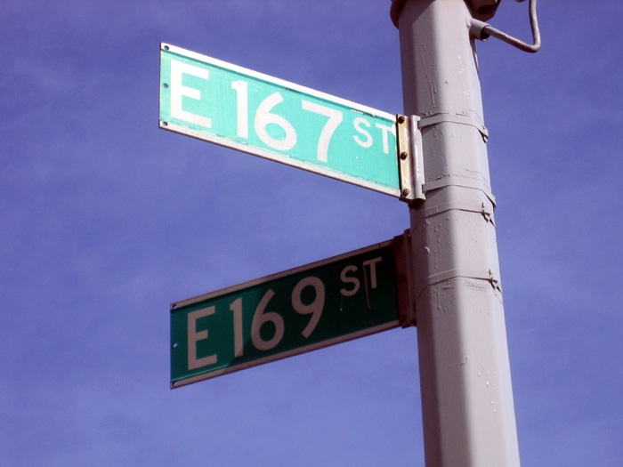
Financials
Treasurer and Budget Reports:
The MAA continues to be healthy but a review of all income and expenses in order to reverse the recent deficits is being conducted.
2010 was budgeted as a break-even year. Final figures are likely to show deficits due to continued weakness in membership, journals, and advertising. 2011 budget was revised cutting expenses to meet lower revenue expectations.
Investment Committee is working with investment advisor to reconsider asset allocations, and to simplify the portfolio. The continuing financial climate of both the U.S. and the world will continue to make investment outcomes uncertain.
Treasurer’s page is available to members only at: http://www.maa.org/treasurer/. Contains current and historical information about MAA’s finances.

Slide 13
Membership and Marketing
Spring 2010: Launched electronic memberships to student member groups (graduate and undergraduate)
E-members are renewing at a high rate and are not returning to print versions of membership. 25% of members are now e-members.
Current 2011 member retention rates have improved and are exceeding the 2010 results.
Created MAA Branding Guidelines manual.
Summer 2010: Inherited journal advertising function.
Fall 2010: Inherited work related to marketing and support for Sections and SIGMAAs.
Dues will increase by $1-2 in 2012 for most non-student members.

Slide 14
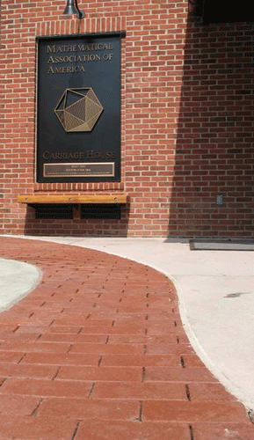
Development and Fundraising
MAA Fall Appeal:
Members’ donation totaled more than $124,000 through the the end of December with donations still arriving.
Donations made in 2010 by fund:
$103,000 to the GMAA
$4,133 to the American Mathematics Competitions
$2,542 to Student Activities
$11,737 to Project NExT
External Sponsorships for:
Project Next Fellows $220,500
American Math Competitions $ 65,000
Mathematical Olympiad Summer Program $ 90,000
USAMO Ceremonies $ 22,000
China Girls Mathematical Olympiad $ 45,000
The Icosahedron Society:
Barbara and Doug Faires are the newest members of the Icosahedron Society, which recognizes individuals, corporations, and foundations who have contributed to the MAA at the highest levels. There are 21 Icosahedron Society Members.
The MAA thanks all of the members who so generously contributed in 2010.

Slide 15
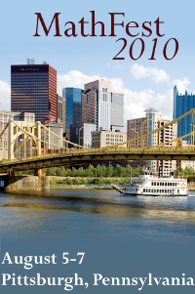
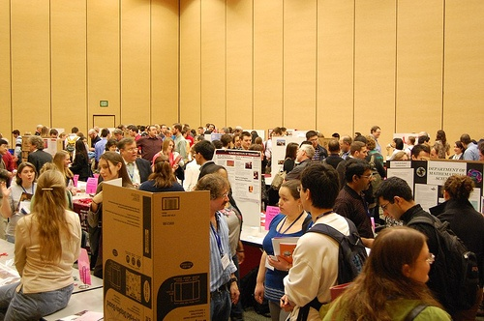
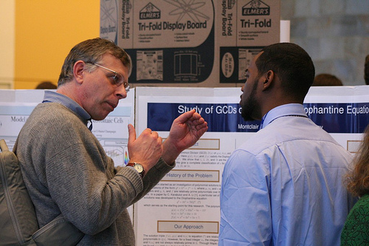
Meetings
MathFest, August 5-7, 2010 in Pittsburgh, PA:
Over 1500 attendees.
Invited lectures now online; available through
MAA website
JMM, January 6-9, 2011 in New Orleans, LA:
6000 attendees-largest JMM ever!
Highlights available at: www.jointmathematicsmeetings.org
View the photo gallery at: www.flickr.com/photos/maaorg/sets/

Slide 16
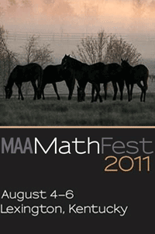
Upcoming Events
April 2011: Math Awareness Month theme is Unraveling Complex Systems. Information at: http://www.mathaware.org.
Summer 2011: PREP workshops. Information at: http://www.maa.org/prep.
MathFest 2011, August 4-6, in Lexington, KY:
Registration available online starting April 1, 2010.
Abstract submission online mid-February, 2010.
More information at: http://www.maa.org/mathfest/
JMM, January 4-7, 2012 in Boston, MA:
More information soon at
www.jointmathematicsmeetings.org

Slide 17
Mathematical Association of America

