Slide 1
Length slow
C-axis
C-axis
B
A
slow + slow in this orientation = addition
fast + slow in this orientation = subtraction
Length fast
C-axis
C-axis
D
C
fast + slow in this orientation = subtraction
slow + slow in this orientation = addition

Slide 2
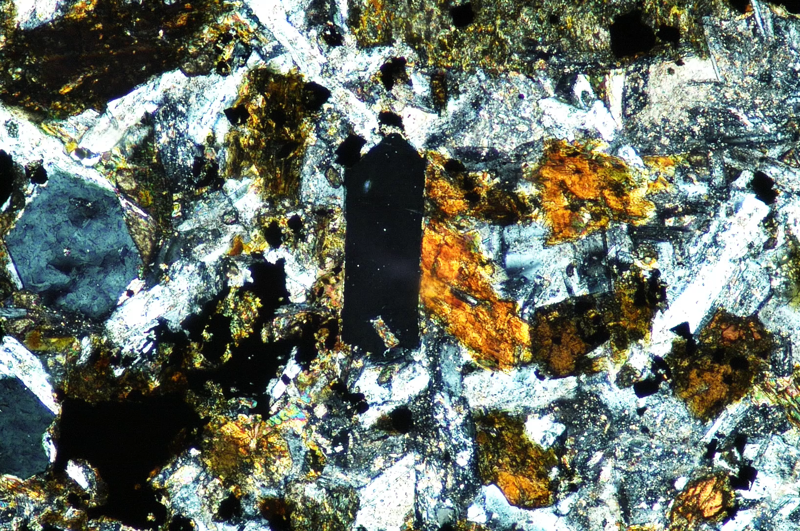
Apatite in thin section BH250-8 (Remember, Apatite is uniaxial negative,
c-axis is perpendicular to the length)
fast + slow in this orientation = subtraction

Slide 3
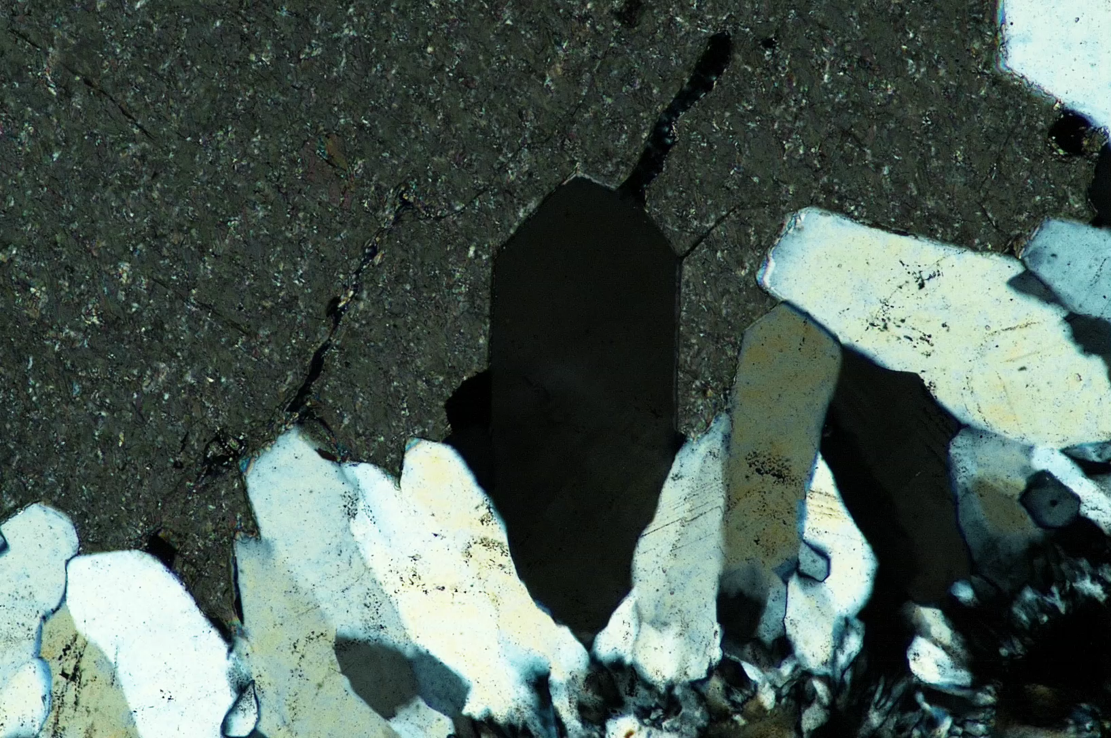
Quartz in thin section BH250-173b
slow + slow in this orientation = addition

